Slide 1

EIE 2001 Basic Circuit Theory
Lecture 3
Circuit Theorems

Slide 2
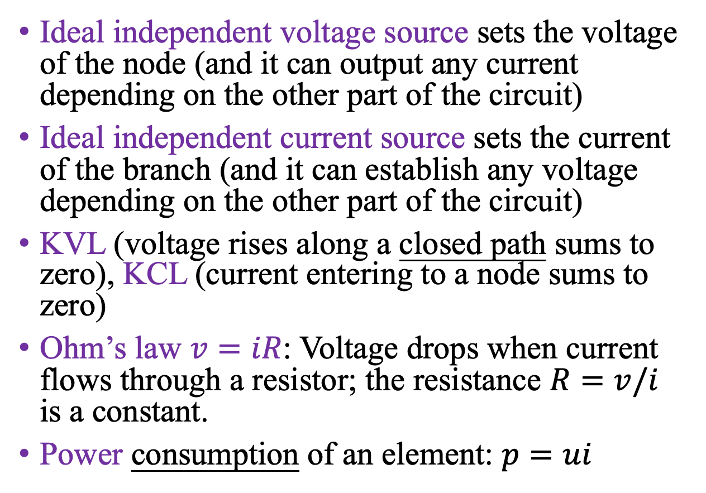
Review: Basic concepts and laws we have learned so far
Ideal independent voltage source sets the voltage of the node (and it can output any current depending on the other part of the circuit)
Ideal independent current source sets the current of the branch (and it can establish any voltage depending on the other part of the circuit)
KVL (voltage rises along a closed path sums to zero), KCL (current entering to a node sums to zero)
Ohm’s law $v=iR$: Voltage drops when current flows through a resistor; the resistance $R=v/i$ is a constant.
Power consumption of an element: $p=ui$

Slide 3
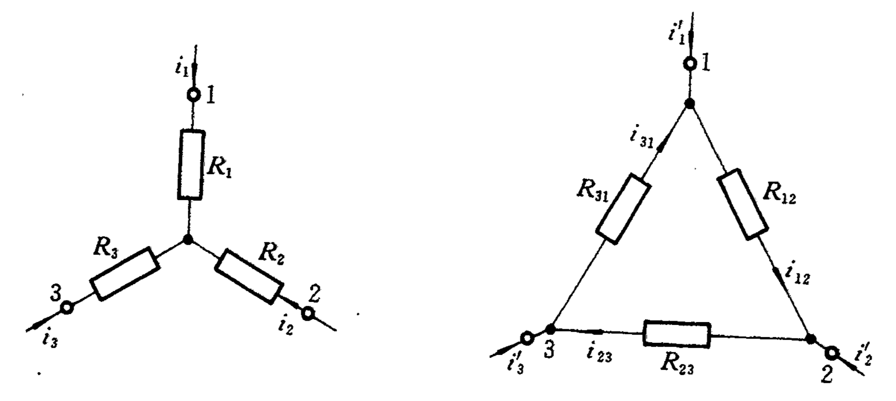
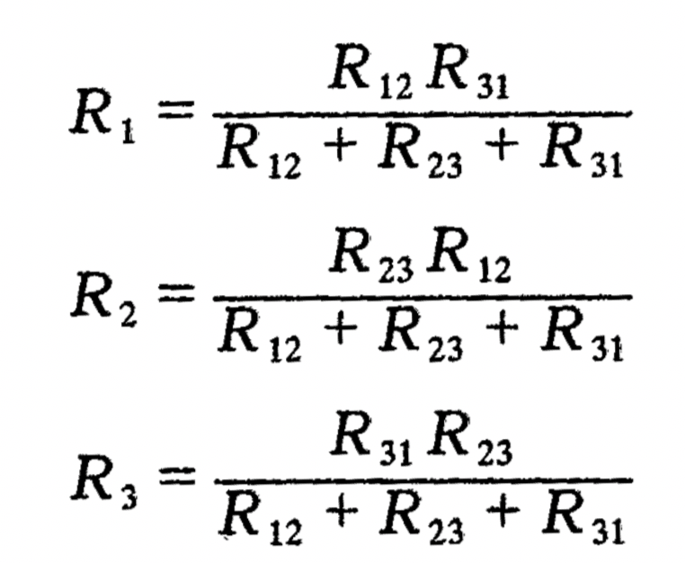
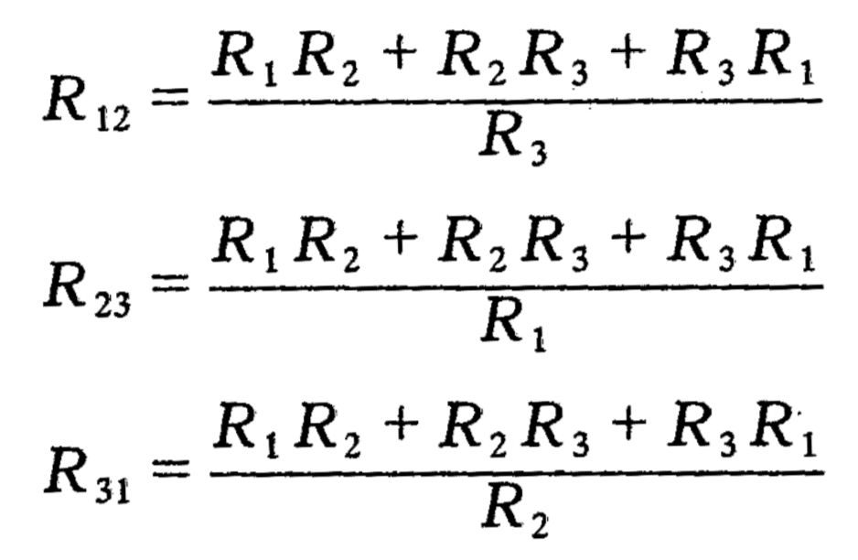

Review: Equivalence in resistor networks
Series resistors: $R_{eq}=R_{1}+R_{2}$
Parallel resistors: $G_{eq}=G_{1}+G_{2}$, where $G=1/R$.
$Y−Δ$ transformation:
△ → Y:
Y → △:

Slide 4
Overview
Technique 1: Principle of Superposition for linear circuits
Technique 2: Source Transformation
Technique 3: Thévenin and Norton’s Theorems
Applications
  Understand power transfer and source modeling

Slide 5
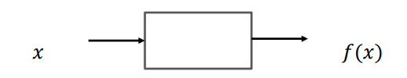
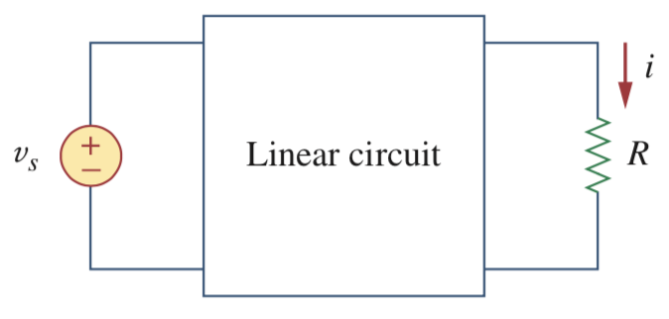

Linearity Property
Excitation
(input)
Response
(output)
System / circuit component
A linear system has the following properties:
  Homogeneity (scaling) property
  Additivity property
$$f\left(ax\right)=af\left(x\right)$$
A linear circuit with input v_{s} and output i.
$$f\left(x1+x2\right)=f\left(x1\right)+f(x2)$$

Slide 6




Example: resistors are linear elements
Recall the Ohm’s law
Homogeneity property: if we consider the current i as an input and voltage v as an output, then the Ohm’s law implies that ki yields kv for any constant k:
Additive property: applying additive inputs yield additive outputs:

Slide 7
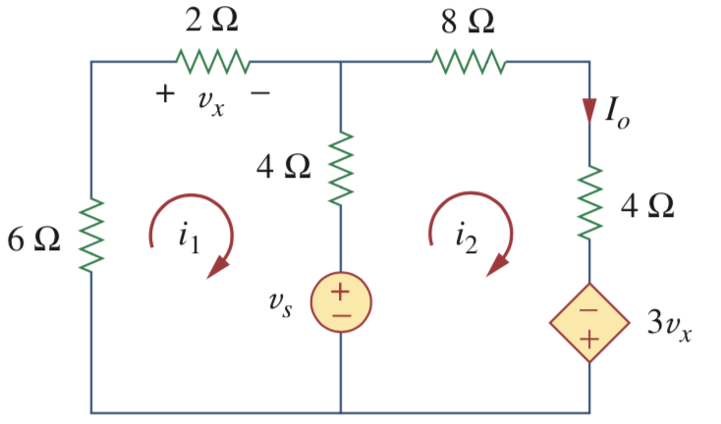

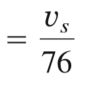


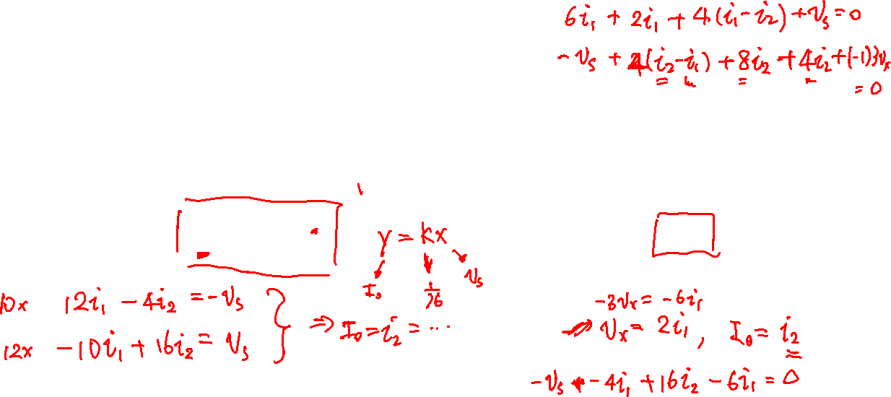

Example: A circuit with resistors, independent sources, and linear dependent sources is also linear
We can basically choose any node voltage or branch current as output for an analysis
In this example, the output I₀ is linearly related to the input v_{s}:

Slide 8
Principle of Superposition in Linear Circuits
The superposition principle states that the voltage across (or current through) an element in a linear circuit is the algebraic sum of the voltages across (or currents through) that element due to each independent source acting alone.
Steps to apply Superposition Principle:
Turn off all independent sources except one source. Find the output (voltage or current) due to that active source
Repeat step 1 for each of the other independent sources.
Find the total contribution by adding algebraically all the contributions due to the independent sources.

Slide 9
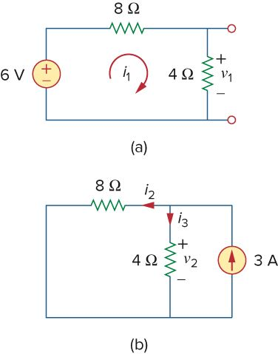
Superposition principle is an application of linearity property
By superposition,
Remove independent current source means
i=0 (open circuit)
Remove independent voltage source means
v=0 (short circuit)

Slide 10
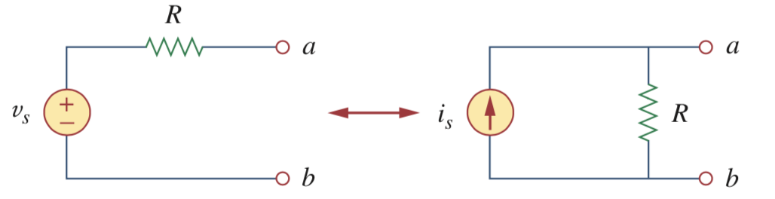
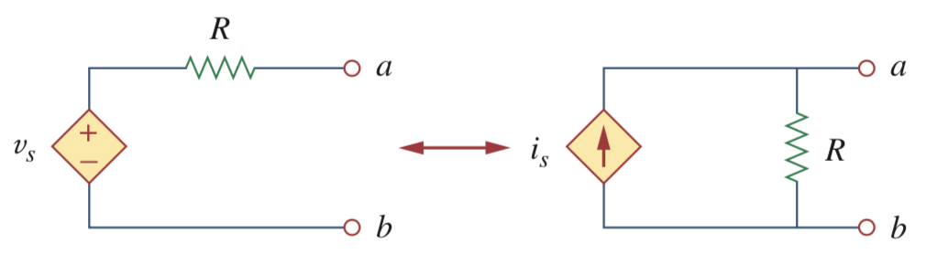
Source transformation
A source transformation is the process of replacing a voltage source v_{s} in series with a resistor R by a current is in parallel with a resistor R, or vice versa.
Transformation of independent sources
Transformation of dependent sources

Slide 11
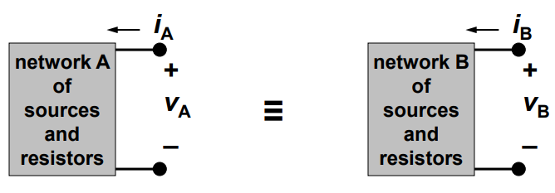

“Transformation” means the two circuits are equivalent
A network of voltage sources, current sources, and resistors can be replaced by an equivalent circuit which has identical terminal properties (I-V characteristics) without affecting the operation of the rest of the circuit.
$$iA=i_{B} , VA=V_{B}$$

Slide 12
We have seen “transformation” or “equivalence” in resistor networks
Recall the resistive circuit, we can find equivalent resistance between two nodes.
These transformations work because two resistive circuits have equivalent behavior at their terminals
Another example is the Y-delta transformation
Resistors in Series
Resistors in Parallel

Slide 13
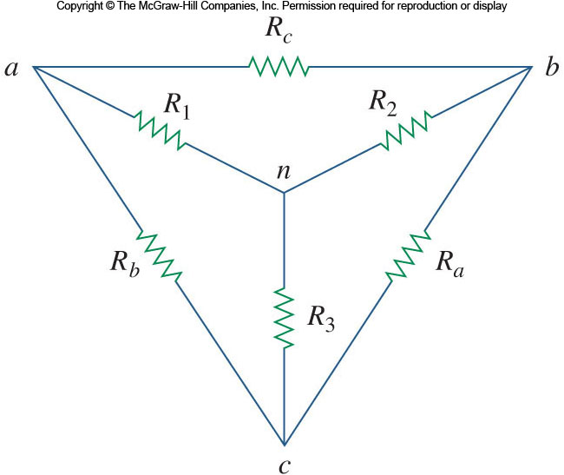
Transformation and Equivalence
For example, the delta-wye transformation;

Slide 14
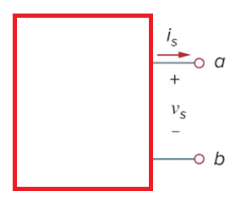
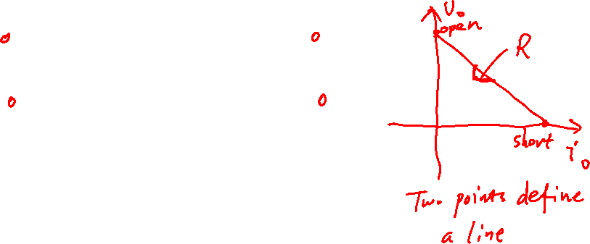
Conditions when two linear circuits are equivalent
  If the independent sources are turned off the resistance at the terminals are the same
  If the terminals are short-circuited, the short-circuit currents are the same; OR, if the terminals are open-circuited, the open-circuit voltages are the same
Circuit A
Circuit B

Slide 15
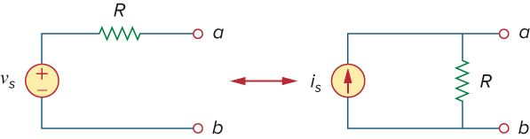
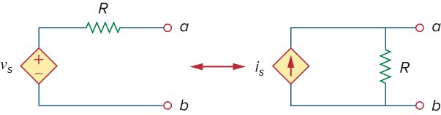
Source Transformation
For independent sources, a voltage source with resistor R in series can be transformed into a current source with the same resistor R in parallel.
Source transformation also applies to dependent sources. But, the dependent variable must be handled carefully; the same relationship between the voltage and current holds here:
Pay attention to the source direction
Notes:
Dependent variable could not be affected during any transformation in the circuit.

Slide 16
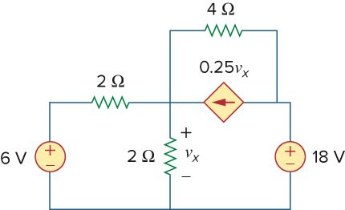
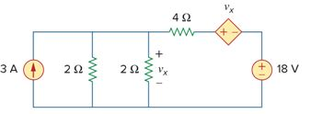
Example of Using Source Transformation

Slide 17
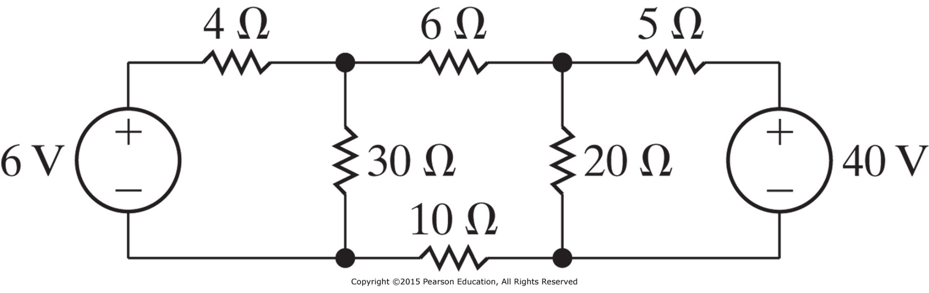
Something more about source transformation
Find power associating with the 6V voltage source.

Slide 18

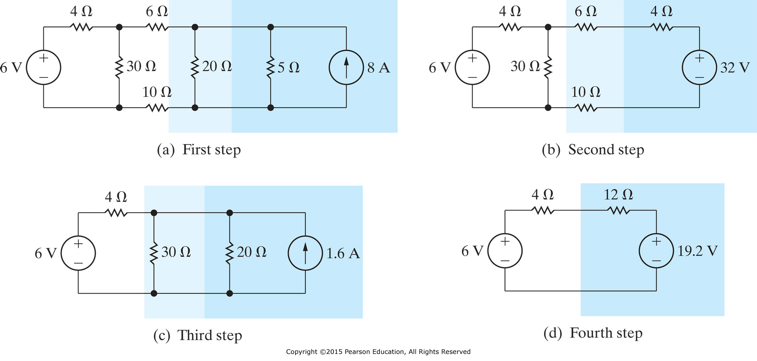

Slide 19
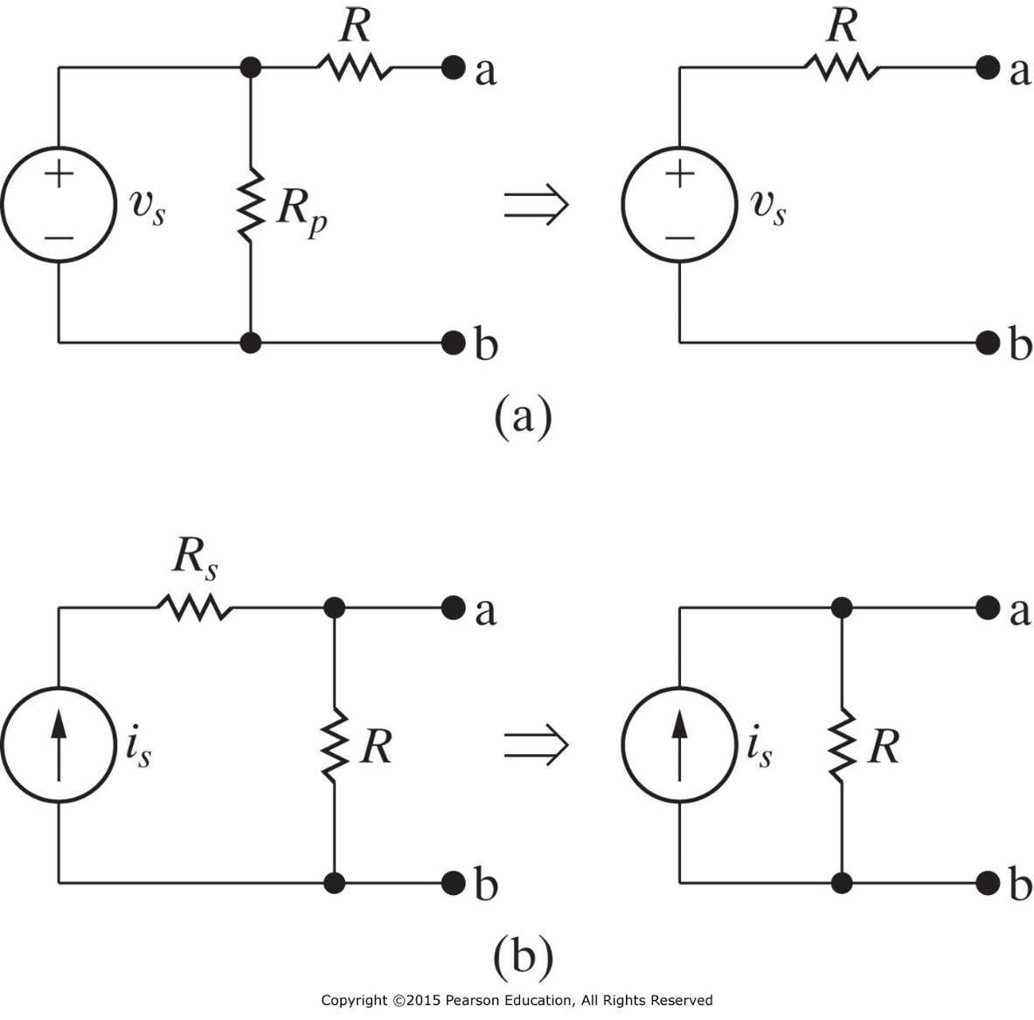
What happens if there is a resistance in parallel with the voltage source or a resistance in series with the current source?
  If the sources are turned off the resistance at the terminals are both R
  If the terminals are short circuited, the currents need to be the same

Slide 20
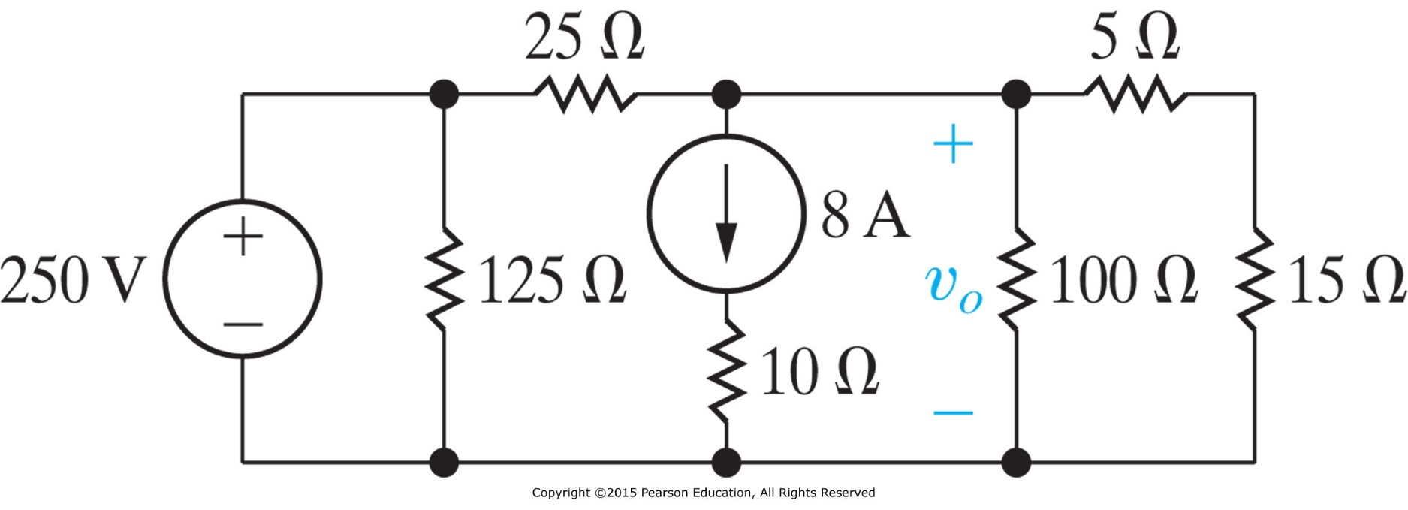
Example
Use source transformation techniques to find the voltage v_{o} in the circuit.

Slide 21

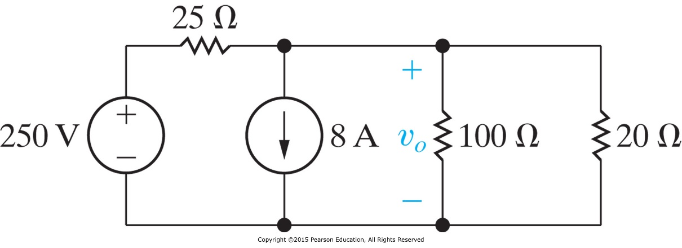
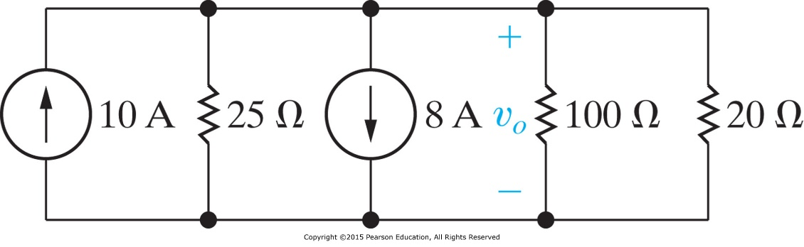
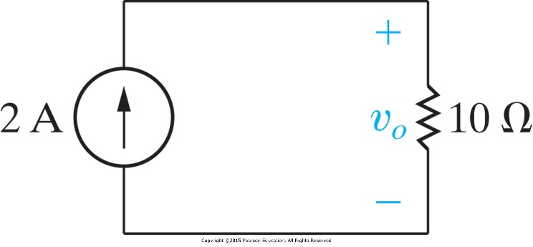

$$v_{o}=20\text{V}$$

Slide 22
Thévenin’s Theorem - Motivation
In many circuits, one element will be variable while others are fixed. This variable element is called the load. In fact, we do NOT have to reanalyze the circuit for every change in the load.
With this goal, Thévenin’s theorem provides a technique by which the fixed part of the circuit is replaced by an equivalent circuit:
Thévenin’s Theorem states that a linear two terminal circuit may be replaced with an independent voltage source V_{Th} in series with a resistor R_{Th}.

Slide 23
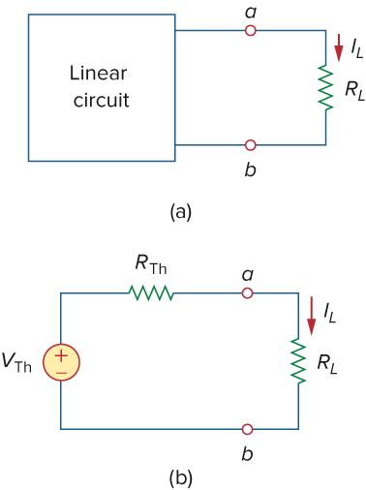


Thévenin’s Theorem
Thévenin’s theorem is very powerful in linear circuit analysis.
It allows one to simplify a circuit. A large circuit may be replaced by a single independent voltage source and a single resistor.
The equivalent circuit behaves exactly the same as the original circuit.
Load current can be calculated with a voltage source and two series resistors. Load voltages use the voltage divider rule.

Slide 24
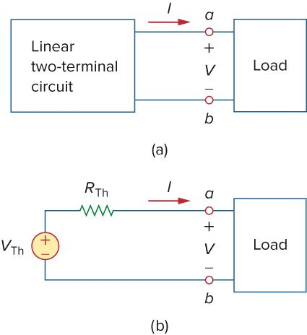

Thévenin’s Voltage: equals to open circuit voltage
This equivalence means that if we connect the same load across the terminals a and b, we get the same voltage and current at the terminals of the load.
To calculate the Thévenin equivalent voltage V_{Th} is straightforward, it equals to the open circuit voltage at the terminals in the original circuit.
$$VTh=V_{OC}$$

Slide 25
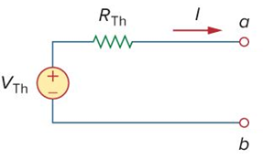
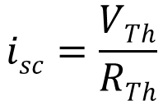
Thévenin’s Resistance (direct method)
Take the other extreme condition by reducing the load to zero; it gives a short-circuit condition. For the equivalent circuit, then we shall have the short-circuit current i_{sc}
By hypothesis, this short-circuit current must be identical to the short-circuit current that exists in the original circuit.
Thus, Thévenin resistance can be found.
$$isc=\frac{VTh}{RTh}$$

Slide 26
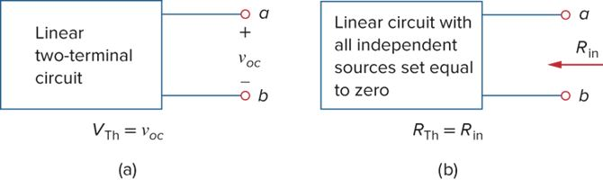
Thévenin’s Resistance (alternative method)
Alternatively, Thévenin resistance can also be obtained without calculating the short-circuit current.
The input resistance at terminals a and b with independent sources zeroed, 𝑅_{𝑖𝑛}, equals 𝑅_{𝑇ℎ}.
Two cases:
Case 1: If there are NO dependent sources, then the resistance may be found by simply turning off all the sources; the resistance equals to the resistance measured at the terminals when the independent sources are turned off.

Slide 27
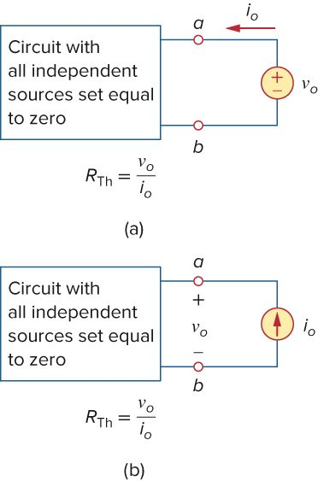
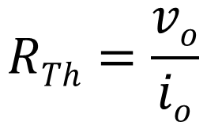
Thévenin’s Resistance (alternative)
Case 2: If there are dependent sources, we still turn off all the independent sources. Now apply a test source, e.g. an independent voltage source v₀ (or current source i₀) to the terminals, and determine the corresponding current i₀ (voltage v₀) in the circuit. Then the Thévenin’s resistance can be calculated by
$$RTh=\frac{vo}{io}$$

Slide 28
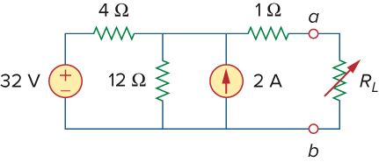
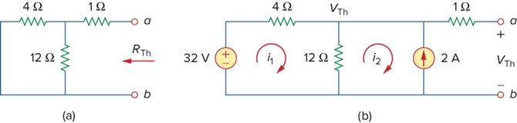
Example (Units: v in V, R in Ω, and i in A are assumed)
Find the Thévenin equivalent circuit of the circuit shown
for finding v_{Th}.
  Use mesh or nodal analysis?
for finding R_{Th}, remove all independent sources (short voltage & open current source)
try to use short-circuit current to find R_{Th}

Slide 29
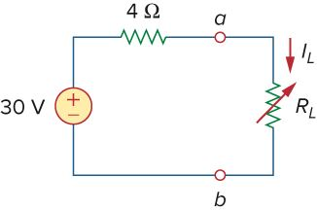
Example (cont’d)
From mesh 1, from mesh 2
Combing,
Therefore
As far as the load R_{L} is concerned, this is the circuit.
V
Ω

Slide 30
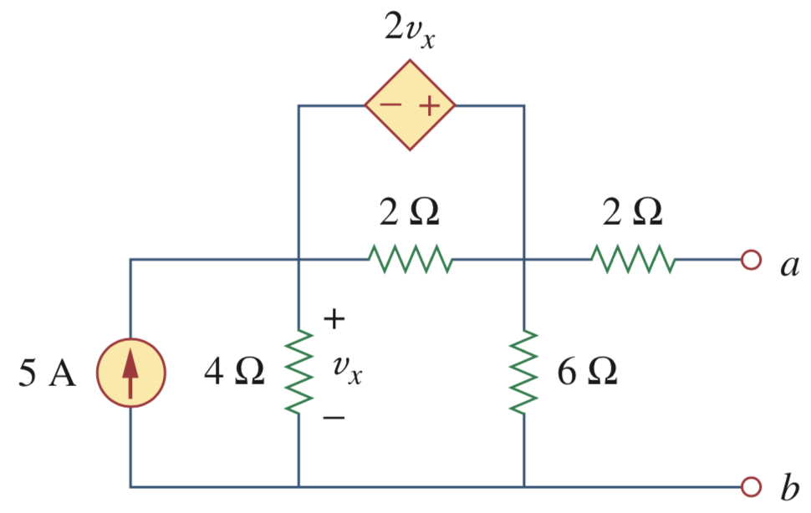
Example (Units: v in V, R in Ω, and i in A are assumed)
Find the Thévenin equivalent circuit

Slide 31
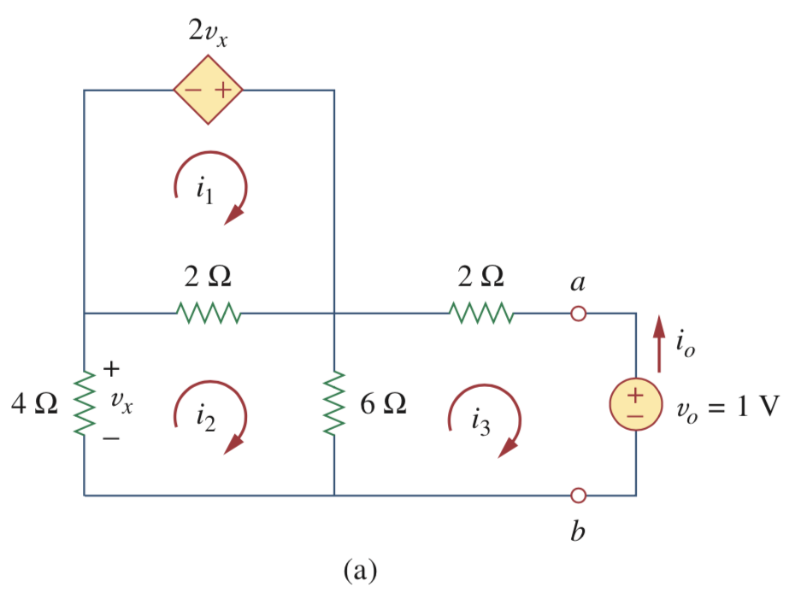
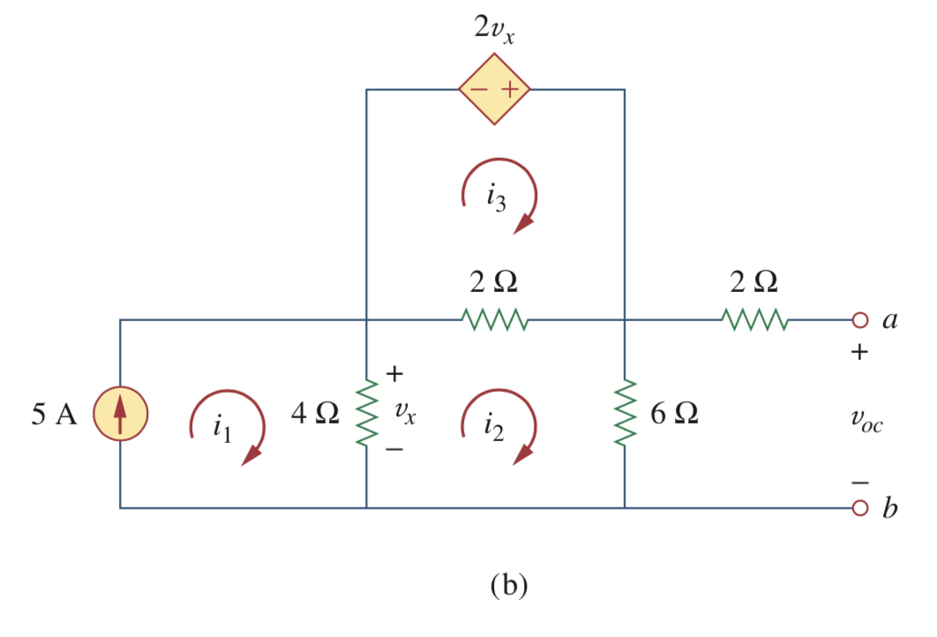
Solution (alternative method with a test source)
Answer: R_{Th}=6Ω and V_{Th}=20V
(a) Excite the network with a voltage source to find R_{Th}
(b) Find the open-circuit voltage for v_{Th}

Slide 32
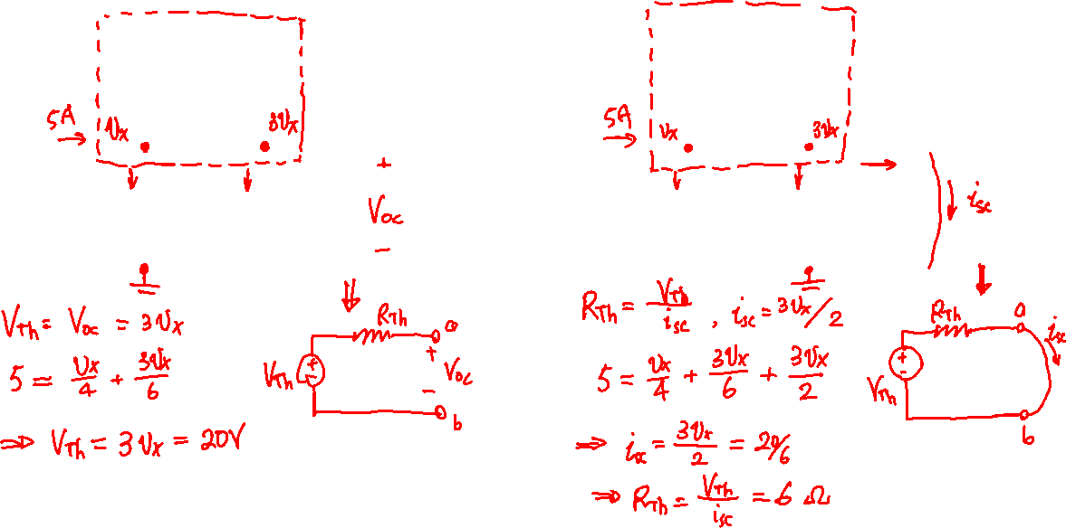
Solution (direct method)

Slide 33
Question:
Is it possible for the result of the equivalent circuit to end up with a negative resistance?
The answer is Yes!
  It is possible to get a negative Thévenin resistance (or voltage).
  This is reasonable with dependent sources.
  For example…

Slide 34
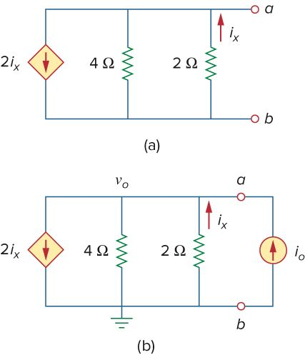
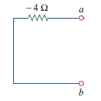
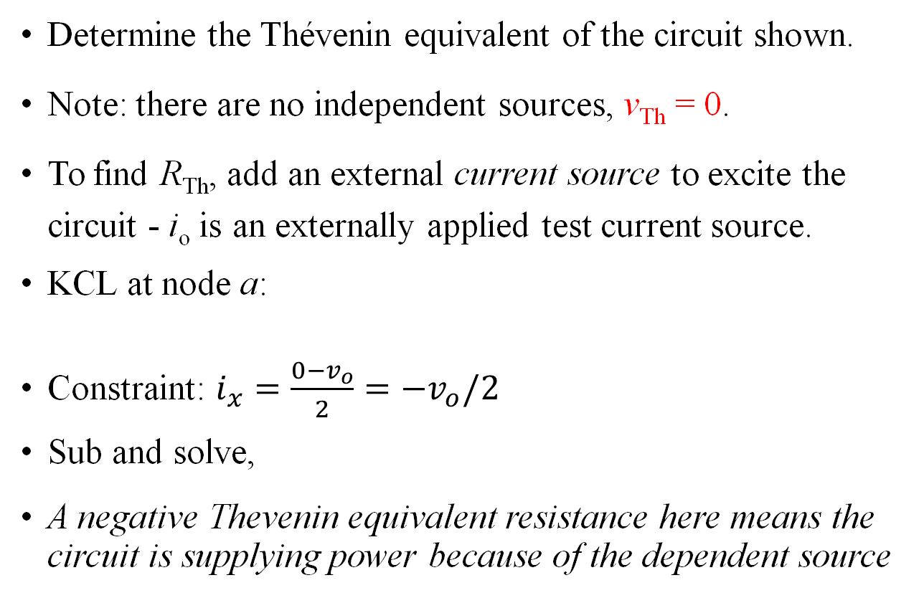

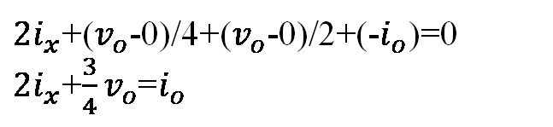
Example of -R_{Th}
Determine the Thévenin equivalent of the circuit shown.
Note: there are no independent sources, v_{Th} = 0.
To find R_{Th}, add an external current source to excite the circuit - i_{o} is an externally applied test current source.
KCL at node a:
Constraint: $i_{x}=\frac{0−v_{o}}{2}=−v_{o}/2$
Sub and solve,
A negative Thevenin equivalent resistance here means the circuit is supplying power because of the dependent source
$2i_{x}$+($v_{o}$-0)/4+($v_{o}$-0)/2+(-$i_{o}$)=0
$2i_{x}$+$\frac{3}{4}v_{o}$=$i_{o}$
$$R_{Th}=\frac{v_{o}}{i_{o}}=−4$$

Slide 35
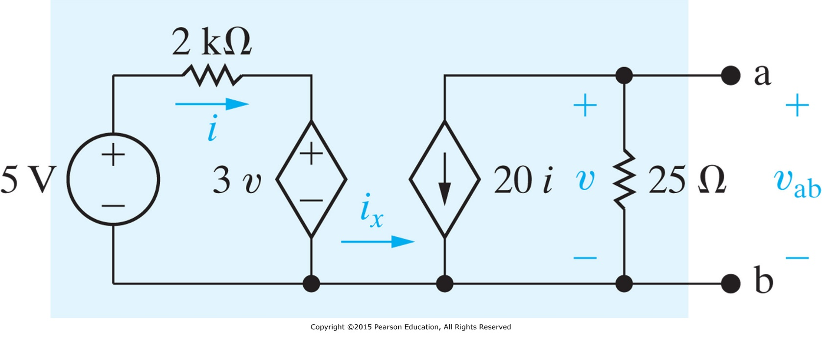
Example of -V_{Th}
Determine the Thévenin equivalent of the circuit shown.
Answer: R_{Th}=100Ω and V_{Th}=-5V

Slide 36
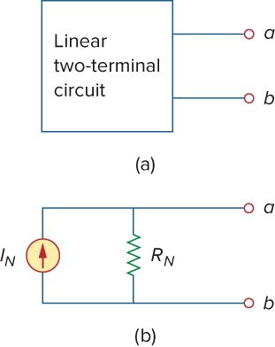

Norton’s Theorem
Similar to Thévenin’s theorem,
The Norton resistance will be exactly the same as the Thévenin
Norton’s Theorem states that a linear two terminal circuit may be replaced with an equivalent circuit containing a resistor and a current source

Slide 37
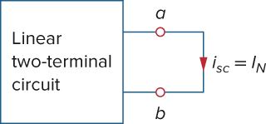
Norton’s Theorem
The Norton current i_{N} is found by short circuiting the circuit’s terminals and measuring the resulting current.
Dependent and independent sources are treated the same way as in Thévenin’s theorem.
Recall source transformation

Slide 38
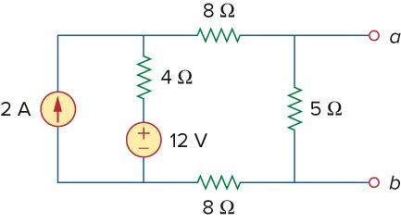


Example
Find the Norton equivalent circuit of the circuit shown.
To find R_{Th}, consider auxiliary figure (a)
To find i_{N}. short terminals a & b, obtain auxiliary figure (b).
  5Ω is immaterial.
  Apply mesh analysis,
Thus
i₂ = 1 A = i_{sc} = I_{N}

Slide 39



Example (cont’d)
Alternatively, consider circuit (c), and
find its open circuit voltage.
This is like to solve the Thévenin equivalent circuit first and the transform it into the Norton’s equivalent circuit.
v_{oc} = V_{Th} = 5i₄ = 4 V

Slide 40
Norton vs Thévenin
Norton’s and Thévenin’s theorems are closely related (dual pair):
The Thévenin and Norton equivalent circuits are related by a source transformation.

Slide 41
Norton vs Thévenin
Finding the Thévenin or Norton equivalent circuit requires that we find:
  The open-circuit voltage across terminals a and b.
  The short-circuit current at terminals a and b.
  The equivalent or input resistance at terminals a and b when all independent sources are turned off.
  Calculate any two of the three using the method that takes the least effort and use them to get the third using Ohm’s law.

Slide 42

Derivations of Thévenin’s & Norton’s Theorem
Both theorems can be derived using Superposition principle:
Thévenin’s Theorem
To have equivalent circuit, it requires same i-v relation at terminal a & b for the linear circuit.
Apply an external current source to terminals a & b.
Assume circuit (a) contains independent voltage sources
v_{sj} and current sources i_{sk,} j=1,2 …m; k=1, 2, … n.
By superposition, we can express the terminal voltage v in circuit (a) as
where A₀, A₁, A₂, A₃, and A₄ are constants.

Slide 43
Derivations of Thévenin’s & Norton’s Theorem
Collect terms for the internal independent sources together as C₁.
where can be considered as a constant.
So when terminals a & b are open, .
When all independent sources are turned off, the dead circuit can be replaced by an equivalent resistance and
So in general , which is what would be obtained from circuit (b).

Slide 44

Derivations of Thévenin's & Norton’s Theorems
Norton’s Theorem
When circuit (a) is driven by an independent voltage source, one considers these two situations on the right.
By superposition and similar arguments,
where D₁ contains the contributions to i due to all internal independent sources, which can also be identified as the short circuit or Norton current.
Turn off this component D₁, the dead current due to the external voltage source is
Finally

Slide 45
Application I: Compute the Maximum Power Transfer to a Load
We will be able to analyze this circuit in the later part of the lectures
Speaker circuit
Thévenin’s equivalent circuit

Slide 46
Maximum Power Transfer
Circuit analysis plays an important role in circuit design, as transferring power from a source to a load.
Power transfer in two aspects:
  Power transfer efficiency maximization (fixed load, adjust system) – e.g. power system
  Maximum Power transfer (fixed system, adjust load) – e.g. communication system
Here we assume a linear system to deliver power to a load. Using Thévenin’s & Norton’s Theorem, we can calculate the maximum power transferred in the system.

Slide 47


Thévenin’s and Norton’s theorems simplify the calculation of load matching
We can use the Thévenin equivalent circuit for finding the maximum power in a linear circuit
We will assume that the load resistance can be varied.
Looking at the equivalent circuit with load included, the power transferred is:
constants
Plot the function
variable

Slide 48


R_{Th} = R_{L} for maximum power transfer
For a given circuit, V_{Th} and R_{Th} are fixed. By varying the load resistance R_{L}, the power delivered to the load varies as shown.
You can see that as R_{L} approaches 0 and ∞ the power transferred goes to zero.
In fact the maximum power transferred is when R_{Th} = R_{L.}
Mathematically, we can show that:

Slide 49

Application II: Source Modeling
An ideal voltage source provides a constant voltage irrespective of the current drawn by the load, while an ideal current source supplies a constant current regardless of the load voltage.
Practical voltage (a) and current (b) sources are not ideal, due to their internal resistances or source resistances R_{s} and R_{p}. They become ideal as R_{s} → 0 and R_{p} → ∞.

Slide 50



Source Modeling I
Take the Thévenin circuit with load resistor:
  The internal resistor and the load act a voltage divider.
  The lower the load resistance (heavier load), the more voltage drop that occurs in the source
This means that as the load resistance increases ($R_{L}≫R_{S}$), the voltage source comes closer to operating like the ideal source.

Slide 51



Source Modeling II
Similarly, with a realistic current source, the internal resistor in parallel with the ideal source acts to draw current that would otherwise go to the load.
  Here, the load and the internal resistor act as a current divider.
  From that perspective, the lower the load resistance, the more current passes through it.
Thus lower load resistance ( ) leads to behavior closer to the ideal source.
$$R_{L}≪R_{p}$$

Slide 52


Application III: Resistance Measurement
Recall the Wheatstone bridge method to measure resistance
It is based on the principle of the voltage divider
Adjust R₂ until there is no current flowing through the galvanometer (which means a instrument to measure very small electric current)
The unknown

Slide 53

Example: Unbalanced Bridge
The key to the high accuracy lies in the fact that any slight difference in the voltage dividers will lead to a current flow.
Find the current if the galvanometer has an internal resistance of 40 Ω
  Looking into the circuit from terminals a & b:
  Its Thévenin resistance is (units: R in
  kΩ, current mA, voltages V)

Slide 54

Example: Unbalanced Bridge
Voltage division
The negative sign indicates that the
current flows in the direction opposite to the one assumed, that is, from terminal b to terminal a.

Slide 55
Expected learning outcomes
Understand the concepts of linearity, equivalent circuits.
Be able to explain the superposition principle and the source transformation principle using concepts of linearity property and equivalent circuits.
Be able to analyze a circuit using these techniques
  Superposition principle
  Source transformation
  Thévenin’s and Norton’s theorems
Understand the concept of maximum power transfer

